Slide 1
Brick-by-brick
Foundational Azure Databricks Concepts

Slide 2
Agenda
Intro
What is Databricks?
Use cases
ETL/ELT
Structured Streaming
Machine Learning

Slide 3




Michael Huffer
Lead Data Analytics Consultant at DMI
Bachelor’s Degree in Applied Mathematics from Franklin College
Master’s Degree in Statistics from Ball State University
Avid Chicago Bears fan
Email: mdhuffer299@gmail.com
GitHub: https://github.com/mdhuffer299
LinkedIn: https://www.linkedin.com/in/michael-huffer-8664086a

Slide 4
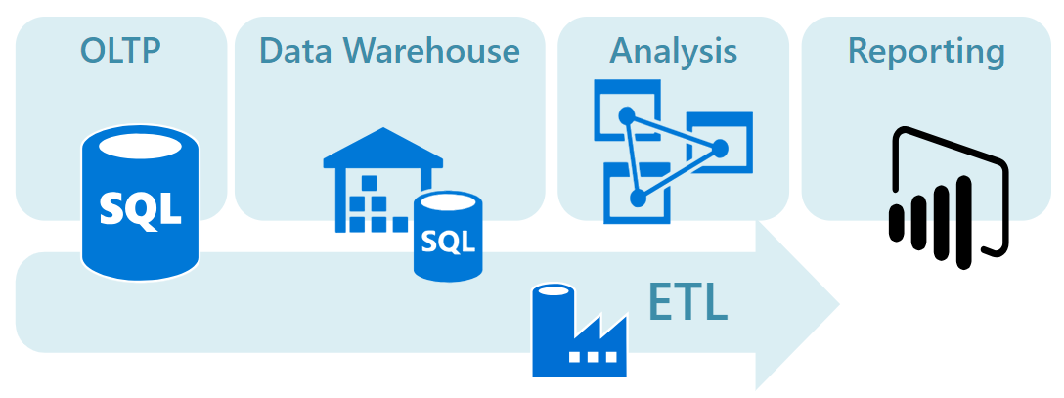
Traditional Data Analytics
Relational Data
Scalability is limited
Upfront data modeling
Difficult and time consuming to modify
Limits access to data for additional insights
Notes:
What are some of the problems that big data pipelines, Spark/Databricks tries to solve?

Slide 5
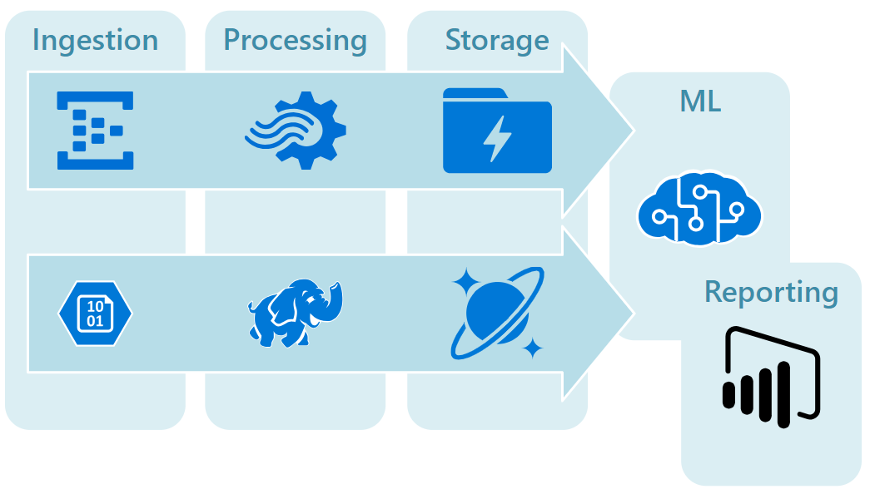
Big Data Architecture
Batch processing for data sources at rest.
Real-time processing of data in motion.
Interactive exploration of big data
Predictive analytics and machine learning.
Store and process large volumes of data too large for traditional architectures.
Transform unstructured data for analysis and reporting.
Notes:
Ability to process data that is at rest, as well as processing data that is in motion.
Ability to consume data in multiple formats/structures.
Allow for ad-hoc exploration of your data
Ability to combine sources of data together that you may not of been able to do before.
Environment to build and productionalize Machine learning models.

Slide 6
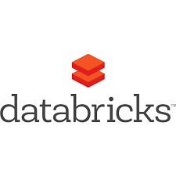




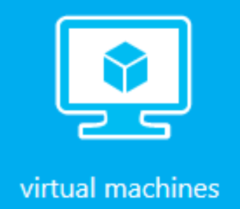
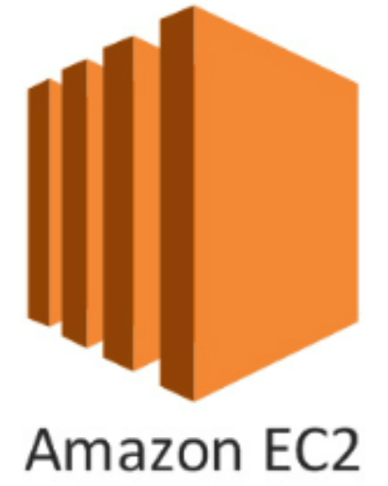
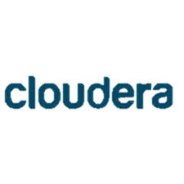
Big Data Cloud Options
PaaS
IaaS
Higher
Lower
Complexities

Slide 7

What is Spark?
“Apache Spark is a fast, in-memory data processing engine with elegant and expressive development APIs to allow data workers to efficiently execute streaming, machine learning or SQL workloads that require fast iterative access to datasets.” - Hortonworks
MLlib
Machine Learning
Streaming
Real-Time Analytics
SQL
Interactive Queries
GraphX
Graph Processing
R
Python
Scala
Java
Notes:
Spark provides a high level APIs in Java, Scala, Python, and R. Allows you to speed up data processing by effectively partitioning data sets and processing the data in parallel. A key feature of spark is the Lazy evaluation of data. This allows spark to build execution plans and until an action is performed (data is requested), does the plan actually get executed. Core spark consists of 4 main libraries (Mllib, Streaming, SQL, and GraphX)

Slide 8
What is Databricks?
An abstraction of Apache Spark that enables a unified and scalable approach to big data pipelines.
Databricks Workspace
Databricks Workflows
Databricks Runtime
Databricks I/O (DBIO)
Databricks Serverless
Databricks Enterprise Security (DBES)
Notes:
Databricks was made to make managing and accessing big data simple.
It leverages Apache Spark™ to provide businesses with a unified data pipeline framework.
Zero-management cloud platform built around Spark to deliver:
Fully managed Spark clusters
An interactive workspace for visualization and exploration
A production pipeline scheduler
A platform for powering Spark-based applications

Slide 9
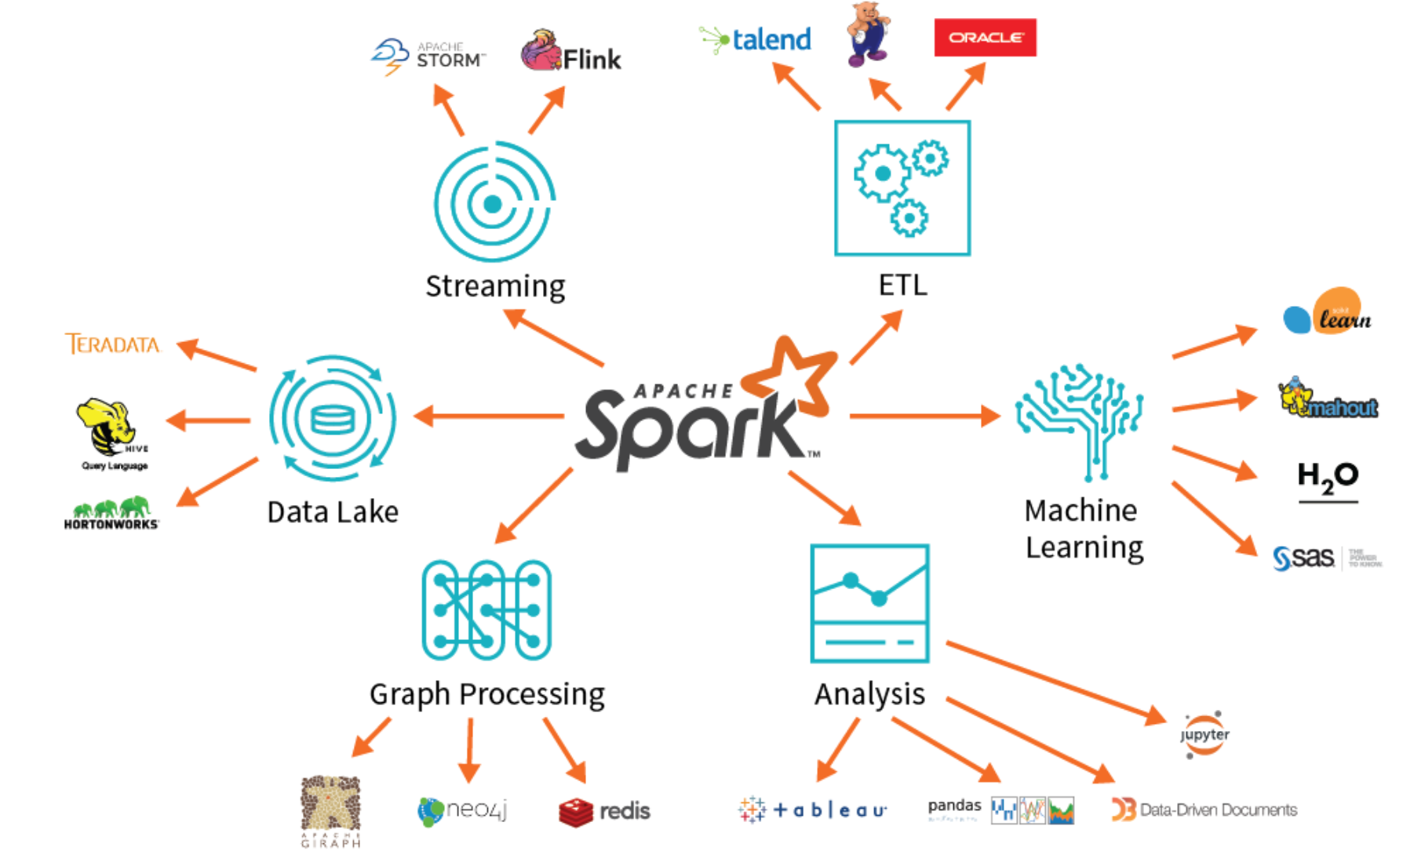
Why databricks?
Zero management platform to deliver fully managed Spark clusters.
Connectors to virtually any data source.
Combines ETL, stream processing, machine learning and collaborative notebooks.
Scalable to petabytes of data and clusters to thousands of nodes.
Decouples data storage from the compute and query engine.
Notes:
With Spark and ultimately Databricks, you get all of those capabilities you are looking for in a big data ecosystem in a single unified platform.
No need to have python or R connecting to your cluster, or trying to wrangle with multiple data platforms to generate different types of data models.

Slide 10





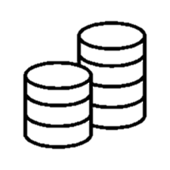



Overview
Data Applications
Workflow C
Workflow C
Workflow C
Workflow B
Workflow B
Workflow B
Databricks
Workflow A
Workflow A
Workflow A
Data Sources
Flat Files
Databases
IoT Devices
Web Apps
Media Files

Slide 11
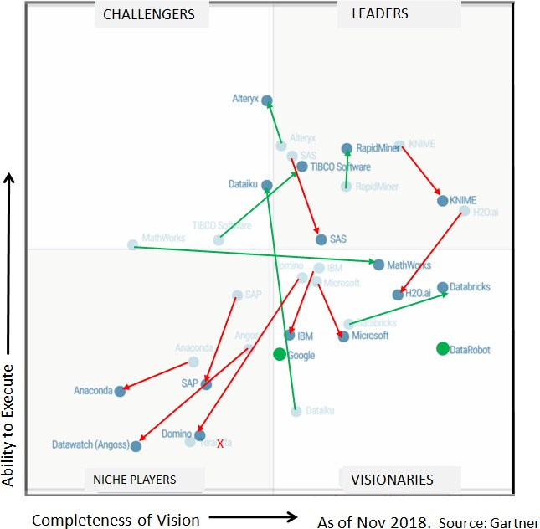
Gartner Magic Quadrant – 2017 to 2018
Gartner Data Science Platform Definition:
Mixture of basic building blocks for creating all kinds of data science solutions.
Strengths
Innovation
Microsoft Partnership
Customer Appreciation
Cautions
Pricing and Contracts
Debugging Errors
Cost Monitoring
Notes:
Databricks remains a Visionary by providing support for the end-to-end analytic life cycle, hybrid cloud environments and accessibility for a wide variety of users. A focus on innovation and a consistently strong and comprehensive product offering have enabled Databricks to improve its position for both Ability to Execute and Completeness of Vision.
Strengths
Innovation: Breadth and ease of open-source integration, streaming IoT capabilities and operationalization capabilities are key differentiators for Databricks. Its platform extends on open-source capabilities by providing the framework needed for end-to-end enterprise scalability, performance and operationalization. Databricks Delta, launched in October 2017, provides a managed cloud service for unified data management with support for streaming analytics and ML. MLflow, launched in June 2018, includes support for experimentation, reproducibility and deployment. The Databricks Runtime for Machine Learning provides preconfigured clusters for deep learning.
Partnership with Microsoft: Azure Databricks has quickly gained traction within the Azure community. Azure Databricks adds global scale to Databricks’ effective marketing and sales strategy. It includes an interactive, collaborative workspace for collaboration between data scientists, data engineers and business analysts, single click-to-launch Spark environment capability, and integration with Azure components.
Customer appreciation: Surveyed reference customers scored Databricks in the top quartile for both customer experience and operations. Databricks received the highest overall scores for both overall vendor experience and quality of documentation.
Cautions
Pricing and contract negotiation: Although Databricks reduces the Spark total cost of ownership (TCO) for comparable loads, Databricks’ reference customers scored it in the bottom quartile for evaluation and contract negotiation experience and for predictable, controllable pricing. Customers raised concerns about pricing and value received, relative to investment.
Troubleshooting and debugging: Databricks’ reference customers indicated difficulty with troubleshooting errors and debugging applications. They would like improved debugging aids, as well as assistance with navigating Spark errors.
Cost monitoring and management: Reference customers indicated a need for improved capabilities for monitoring and managing costs between different user groups and managing accounts. Databricks received the second-lowest overall score for predictable and controllable ongoing software cost.

Slide 12
Feature and cost breakdown
Data Engineering Light
Data Engineering
Data Analytics
Managed Spark
Job Scheduling with Libraries
Managed Spark
Job Scheduling with Libraries
Managed Spark
Job Scheduling with Libraries
Job Scheduling with notebooks
Autopilot Clusters
Job Scheduling with notebooks
Autopilot Clusters
Databricks Runtime for ML
Managed MLflow
Databricks Runtime for ML
Managed MLflow
Databricks Delta
Databricks Delta
Interactive Clusters
Notebooks and Collaboration
Ecosystem Integrations
Standard - $0.07 DBU
Premium - $0.22 DBU
Standard - $0.15 DBU
Premium - $0.30 DBU
Standard - $0.40 DBU
Premium - $0.55 DBU
More Information
Notes:
Data Engineering Light: Run Apache Spark batch applications
Data Engineering: Run batch applications on Databricks’ optimized runtime for higher reliability and performance.
Data Analytics: Use Azure Databricks workspace to collaborate on projects, notebooks and experiments.
Databricks Unit (DBU): A unit of processing capability per hour, billed on a per-second usage.

Slide 13
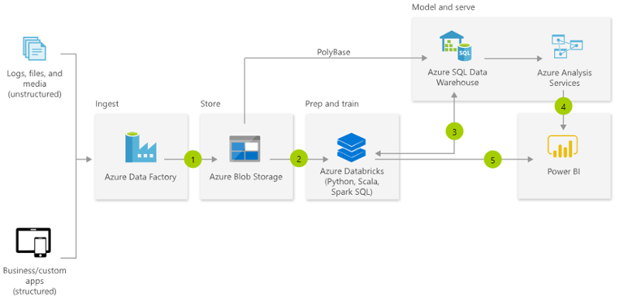
Azure Reference Architecture
Notes:
On Azure, Databricks is a first party service. This means that Microsoft will provide the first line of support when using Databricks in an Azure Tennent. Pricing for workspace in Azure vs. AWS seem to be the same per hour. AWS does require a minimum of $10,000 a month.

Slide 14
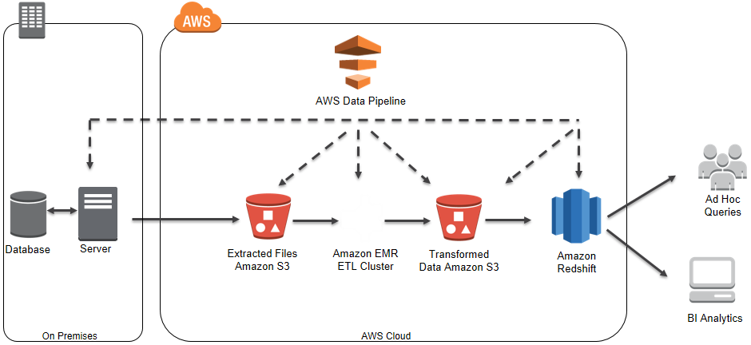
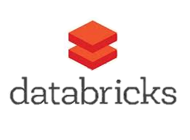
Aws Reference Architecture
Notes:
AWS offers Databricks via their marketplace but to spin it up, you must spend a minimum of $10,000 a month. (Dollar commitments)
https://aws.amazon.com/marketplace/pp/B07K2NJKRW

Slide 15
Cluster Configuration

Slide 16
Databricks etl/ELT

Slide 17
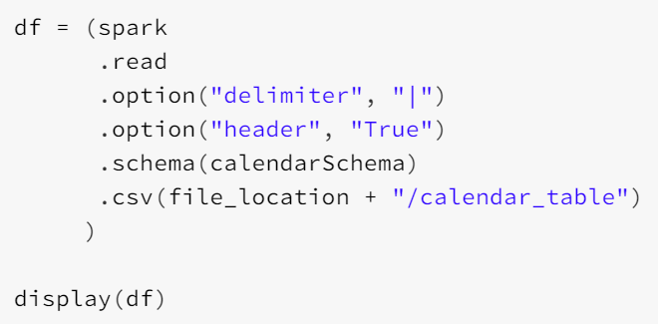




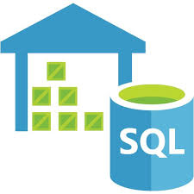



Read and Write Connections
Databricks has a large collection of native connectors for reading and writing data.
File Formats
Databases
Parquet
Redshift
Azure SQL DW
ORC
Full List of Connections Here
Notes:
Databricks has a wide variety of connectors that allow to efficiently read and write data. In the big data world, there are three main file formats: ORC, Parquet, and AVRO. They each have pros/cons and some file formats are more optimized depending on the big data tool you are using. (i.e. Hive prefers ORC and spark prefers Parquet). Efficiently managing your files in a big data world should be a primary thought. Good partitioning and bucketing of your data will ensure quick reads/writes of the data.
There are also multiple database connectors available in Databricks. You can always use the native JDBC connector, but inserts are done row-by-row and it is recommended to use your target database connector.
Structure of a read statement is always the same spark.read.options.schema.format

Slide 18
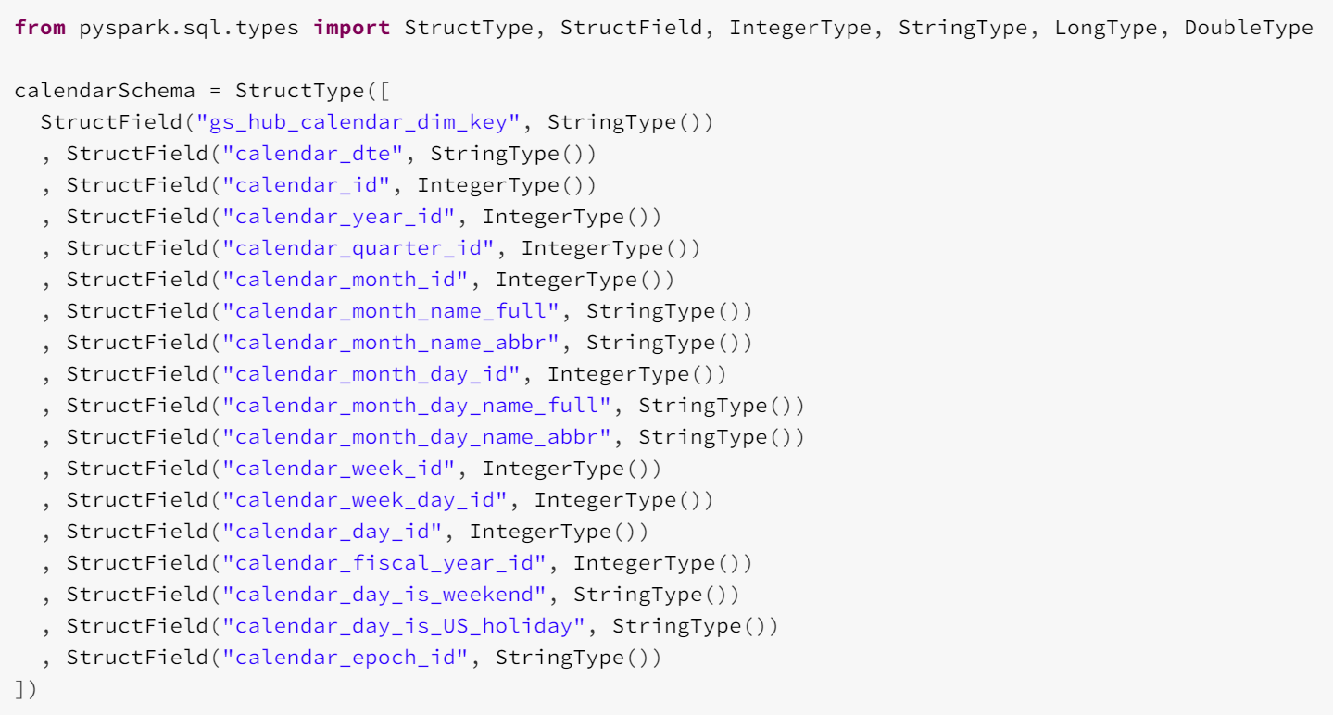
Schema Definitions
Two methods of defining a DataFrame schema:
Infer Schema
Define Schema (Best Practice)
Notes:
When inferring the schema of a file, Spark will make a full scan of the file prior to reading the data in. Preferred approach would be to define the schema whenever feasible.

Slide 19
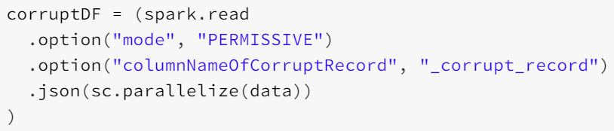
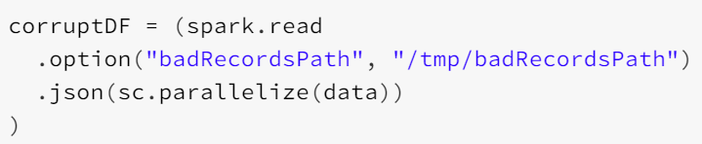
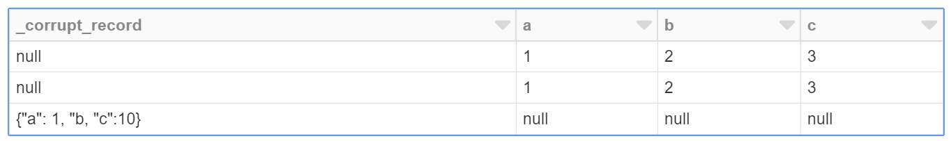
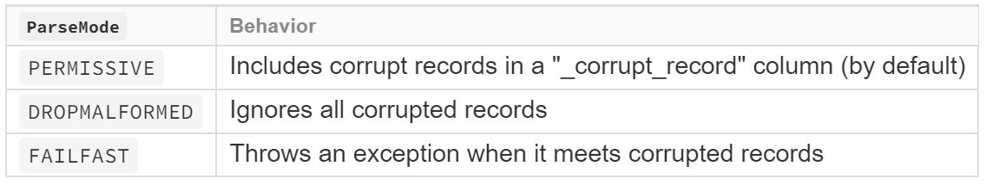
Handling Corrupt records
Missing Information
Incomplete Information
Schema Mismatch
Different Data Types
User Data Producer Errors
Notes:
We want our ETL/ELT jobs to be as robust as possible and gracefully exit failures when possible. Databricks provides the option to parse error records in a couple different ways. With these different options, you can handle erroneous data appropriately. Recommended to use the badRecordsPath to output bad data for future analysis and corrections sent back to the source. You can also build more detailed Error reporting off of this record path.

Slide 20
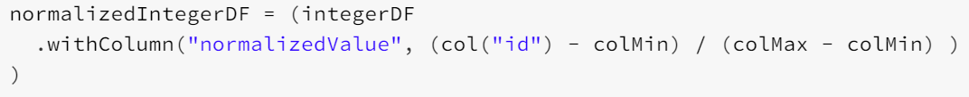
Transformations
Normalizing Values
Imputing Missing Data
Deduplicating Data
Exploding Arrays
Table Aggregations
Pivoting DataFrames
Notes:
After we have extracted the data from our source, we have a wide variety of ways to perform data transformations. Depending on the skill set of your developers, you may choose to build your pipelines in Scala, Python, Java, R, or even SQL via the sqlContext. This allows you to create robust transformation pipelines.

Slide 21
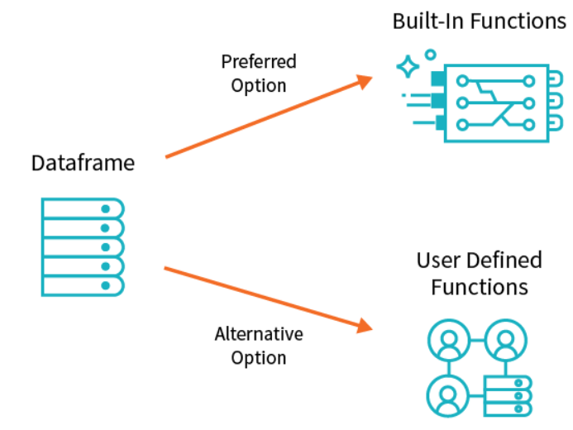
Databricks Functions
Try to use built-in functions whenever possible.
They are finely tuned to run faster than less efficient code you may create.
The Spark optimization engine knows the objective of built-in functions and will reorder your tasks.
Ability to create User Defined Functions when we want to create specific logic and encapsulate it for reuse.
Try to write the UDFs in Scala over Python, when possible.
Notes:
UDFs are generally more performant in Scala than Python since for Python, Spark has to spin up a Python interpreter on every executor to run the function. This causes a substantial performance bottleneck due to communication across the Py4J bridge (how the JVM inter-operates with Python) and the slower nature of Python execution.

Slide 22
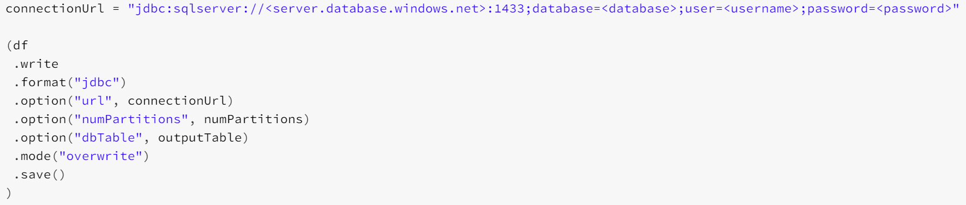
Database writes – JDBC Connection
Databases
Redshift
Azure SQL DW
The number of partitions determine the number of connections used to push data through the JDBC API
General Rule of Thumb:
Number of partitions should be a multiple of the number of cores.
Notes:
For instance, with 5 partitions and 8 slots, 3 of the slots will be underutilized. With 9 partitions and 8 slots, a job will take twice as long as it waits for the extra partition to finish.
JDBC write operations can be very non-performant due to the row by row insertion that is occurring on the target database. Also need to be conscious not to overload our target database with multiple concurrent database writes.

Slide 23
Database writes – Additional Options
Download and install the native connections to respective database on each cluster.
Red Shift
Snowflake
SQL DW
SQL Bulk Copy
Write the data back to simple storage and use bulk insert option from stored procedure.
Databases
Redshift
Azure SQL DW
Notes:
Preferred approach for large bulk data inserts.

Slide 24
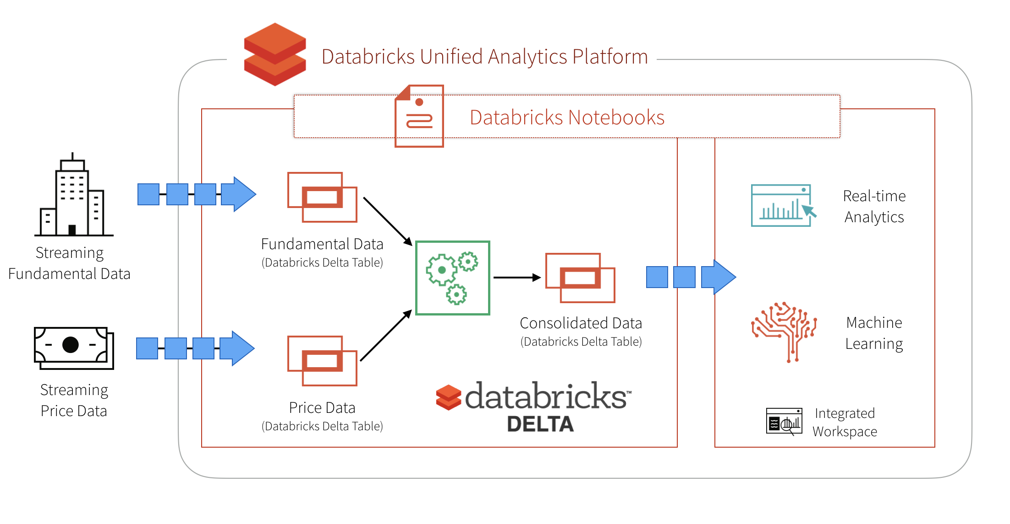
Databricks delta
Unified data management system that brings reliability and performance (10-100x faster than Spark on Parquet) to cloud data lakes.
ACID Transactions
DELETES/UPDATES/UPSERTS
Automatic File Management
Statistics and Data Skipping
Notes:
ACID transactions - Multiple writers can simultaneously modify a data set and see consistent views.
DELETES/UPDATES/UPSERTS - Writers can modify a data set without interfering with jobs reading the data set.
Automatic file management - Data access speeds up by organizing data into large files that can be read efficiently.
Statistics and data skipping - Reads are 10-100x faster when statistics are tracked about the data in each file, allowing Delta to avoid reading irrelevant information.
Delta offers multiple functions to improve read/write performance:
OPTIMIZE - Delta can improve the speed of read queries from a table by coalescing small files into larger ones. You trigger compaction by running the OPTIMIZE command
ZORDER - colocate related information in the same set of files. This co-locality is automatically used by Delta data-skipping algorithms to dramatically reduce the amount of data that needs to be read. To Z-Order data, you specify the columns to order on in the ZORDER BY clause
VACUUM - To ensure that concurrent readers can continue reading a stale snapshot of a table, Delta leaves deleted files on DBFS for a period of time. To save on storage costs you should occasionally clean up these invalid files using the VACUUM command

Slide 25
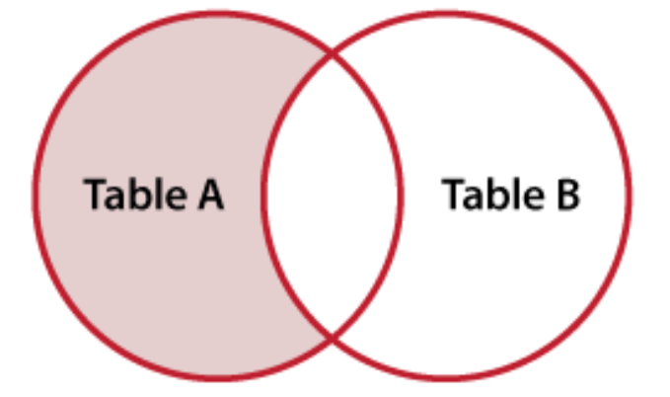
Handling Job failures
Leveraging a left anti-join of new data on data already in a database.
Truncate the target data and reload all of the data.
Take an all-or-nothing approach for data load failures.
Evaluate primary keys to perform an insert or upsert on the target data.
Left Anti-join
Notes:
Since core spark dataframes are immutable in nature, you will need to handle job failures appropriately. You can perform one of the following options when you have job failures.
Left Antijoin
Truncate and reprocess all of the data
Take an all-or-nothing approach for data loads
Evaluate primary keys
Monitoring for job failure often entails a server or cluster that tracks job performance. One common monitoring table to build using this server or cluster is as follows:
batchID: A unique ID for each batch
runID: The ID that matches the API call to execute a job
time: Time of the query
status: Status of the job

Slide 26
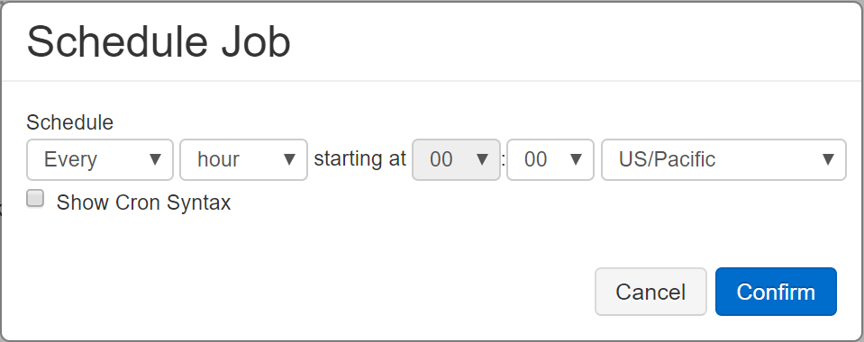
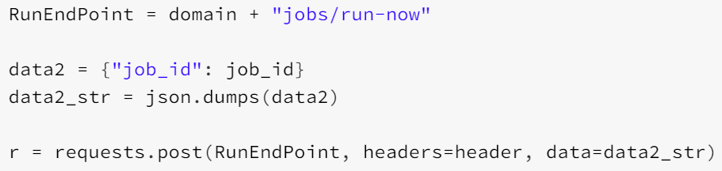
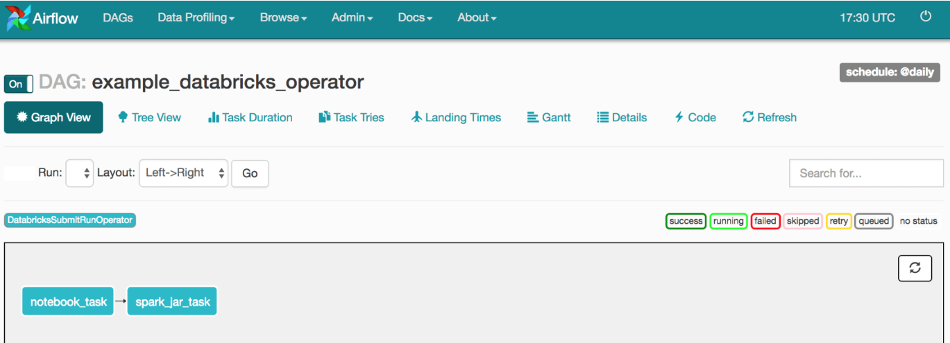
Productionalizing workflows
Built-in Chron Scheduler
API
Apache Airflow
Azure Data Factory

Slide 27
Databricks structured streaming

Slide 28
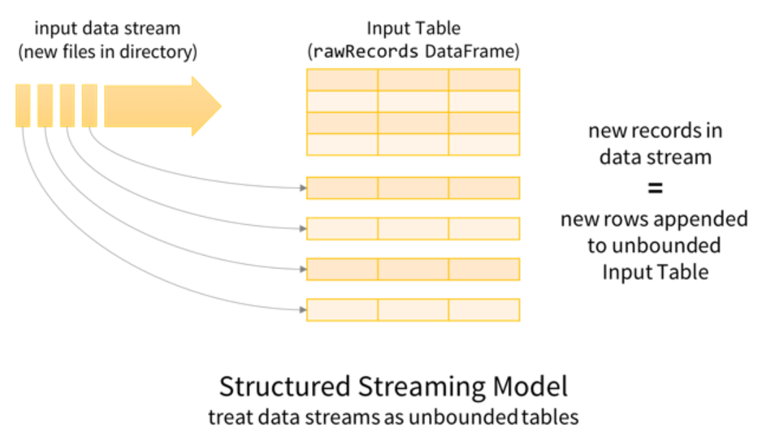
Structured Streaming
Offers the same DataFrame API for interacting with your data.
Instead of having an event stream, you can stream data from a static file directory.
Notes:
You are able to set up a trigger to process each file as a microbatch. This option could lead to potential savings during cluster spin up and down. There are a total of 4 trigger definitions:
Unspecified (Default)
Fixed Interval micro-batches
One-time microbatch
Continuous with fixed checkpoint interval

Slide 29
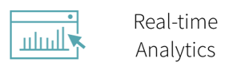







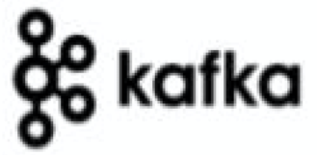

Structured Streaming
Sources
Historical Files

Slide 30
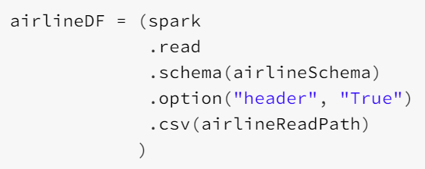
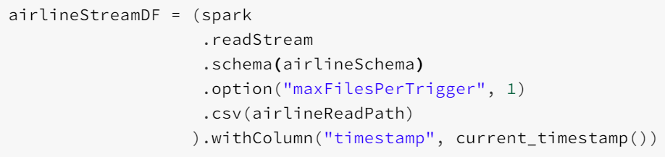
Streaming reads
Notes:
Conversion from a traditional spark read to a streaming object read is pretty straight forward.

Slide 31
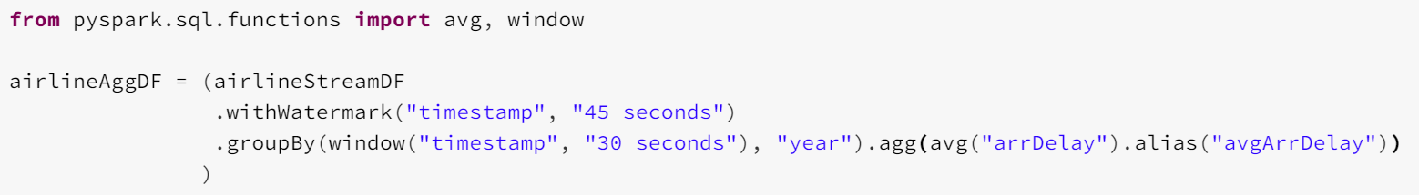
Stream aggregations and transformations
Window
Perform aggregations over data that is bucketed by the defined time window.
Watermark
Defines how long we will wait for late data to arrive. Data outside this timeframe will be dropped.
Notes:
In many cases, rather than running aggregations over the whole stream, you want aggregations over data bucketed by time windows (say, every 5 minutes or every hour).
Watermark is a moving threshold in event-time that trails behind the maximum event-time seen by the query in the processed data. The trailing gap defines how long we will wait for late data to arrive.

Slide 32
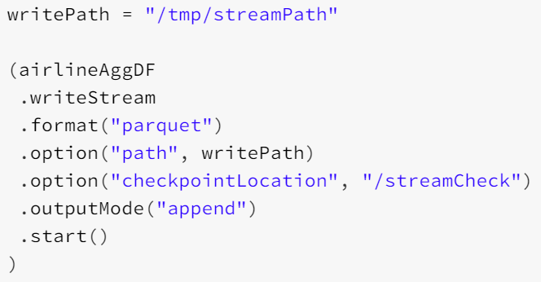
Streaming writes
Append Mode
Complete Mode
Useful for Aggregation Tables

Slide 33
checkpointing
Aides in the recovery from cluster failure.
Checkpoint directory is per query and allows Spark to continuously write metadata.
Notes:
Since a streaming application must operate 24/7, it must be resilient to failures such as system failures.
Two types of data are checkpointed.
Metadata – Configuration of application, Operations, incomplete batches
Data – Necessary for stateful transformations.
Would want to create multiple checkpoint locations to house the metadata of each respective spark streaming object.

Slide 34
Databricks machine learning

Slide 35





Machine learning Algorithms available
Classification
Decision Trees
Regression
Clustering
Recommendation
Notes:
Spark Mllib library has many standard ML algorithms available that take advantage of the distributed nature of Spark. The capability can also be extended to other deep learning/machine learning libraries that are currently available.
Have additional cluster configurations that can take advantage of powerful GPUs.

Slide 36
Machine learning pipelines
Pipeline
Estimator
An algorithm which can be fit on a DataFrame to produce a Transformer.
Transformer
An algorithm which can transform one DataFrame into another DataFrame.
Notes:
Transformers
A feature transformer might take a DataFrame, read a column (e.g., text), map it into a new column (e.g., feature vectors), and output a new DataFrame with the mapped column appended.
A learning model might take a DataFrame, read the column containing feature vectors, predict the label for each feature vector, and output a new DataFrame with predicted labels appended as a column.
Estimator:
a learning algorithm such as LogisticRegression is an Estimator, and calling fit() trains a LogisticRegressionModel, which is a Model and hence a Transformer.

Slide 37
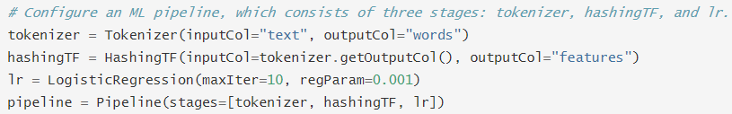
Example Pipeline
Train Data
Pipeline
Fit Model
HashingTF
(Transformer)
Logistic Regression
(Transformer)
Tokenizer
(Transformer)
Logistic Regression
(Estimator)
Test Data
Predictions

Slide 38
Thank you! Questions?

Slide 39
Backup Slides

Slide 40


Big Data Cloud Options
Description:
Fast, scalable infrastructure that provides secure, resizable compute capacity in the cloud. It is designed to make web-scale cloud computing easier for developers.
Description:
Managed cloud Hadoop instances. Offers the full functionality of on-premises Hadoop cluster.
Accelerate Analytical Workloads
Real-time Analytics
ETL/ELT
Predictive Analytics
Use Cases
Notes:
Managed Instance may be the preferred option over Azure SQL DB

Slide 41
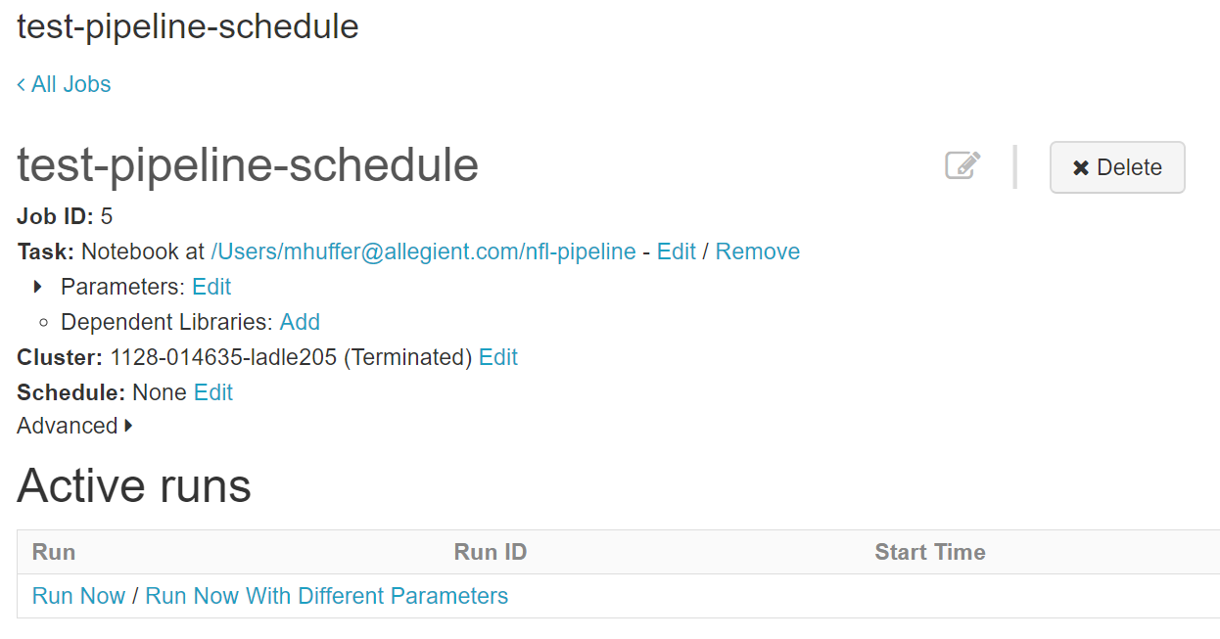
Productionalizing workflows – Built In Scheduler

Slide 42
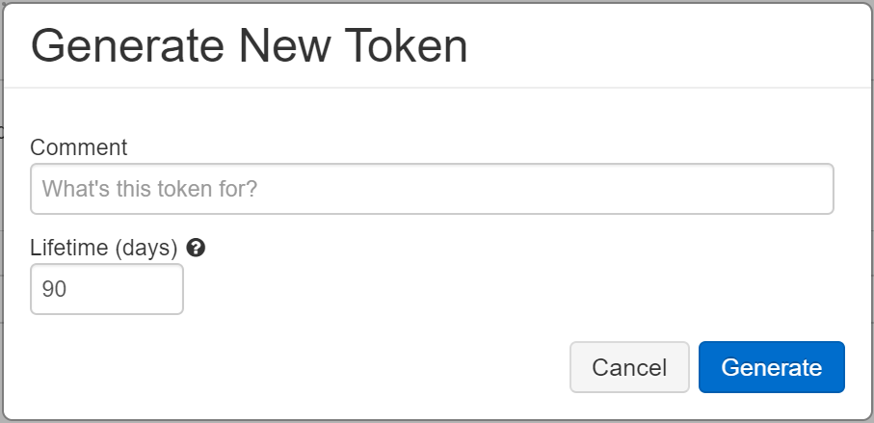
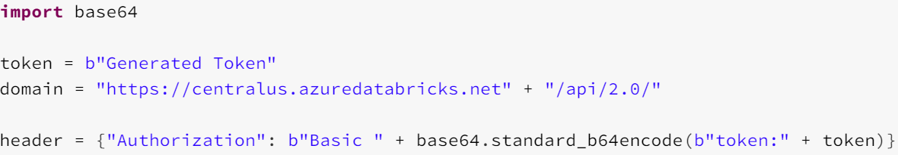
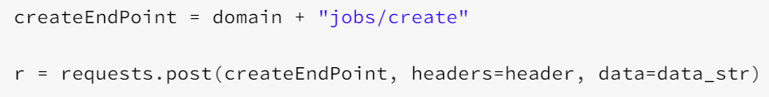
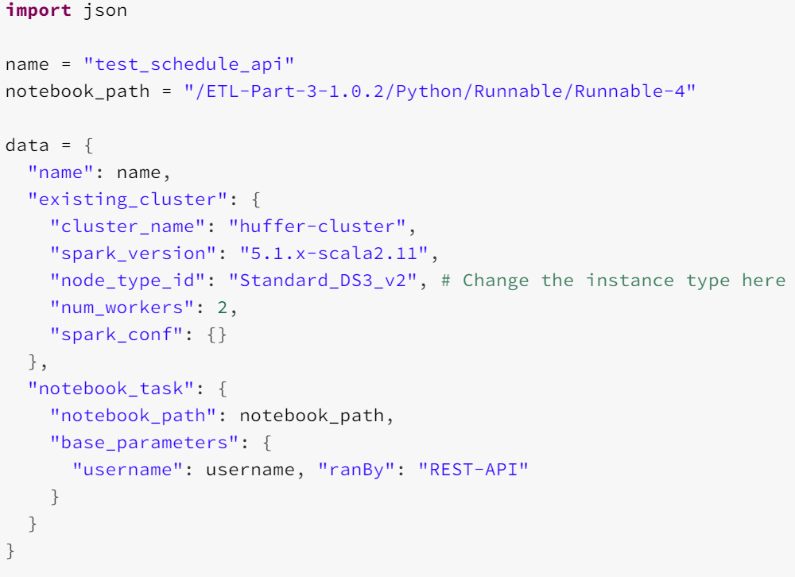
Productionalizing workflows - API
1. Create Token
2. Register Token
3. Define Cluster Configuration
4. Create Job
5. Run Job

Slide 43
Productionalizing workflows - Other
Apache Airflow
Azure Data Factory
Notes:
Databricks recommends using something like Apache Airflow to orchestrate your databricks pipelines.
Azure datafactory allows for quick and easy integration with Azure Databricks.

